Slide 1
Differences in attitudes towards Huguenot immigrants (1500-1750)
www.ourmigrationstory.org.uk

Slide 2
Attitudes to Huguenot migration
Lesson Objectives
Starter task
To know when and why Huguenot immigrants came to Britain
Using two sources, say what we can learn about attitudes towards them
To explain why the sources show differing attitudes towards Huguenots in Britain
List arguments you have heard for and against immigration
During the lesson, compare them to the arguments you hear for and against the immigration of the Huguenots
www.ourmigrationstory.org.uk
Notes:
Starter task: This will need some care when discussing potentially controversial arguments.

Slide 3
Questions based on Huguenot immigration to Britain
Attitudes to Huguenot migration
Which event prompted the first group of Huguenots to come to Britain in the 16th century?
Why does the text suggest they came to Britain?
Why does the text refer to the Huguenots as refugees?
What caused the second large movement of Huguenots to Britain in the late 17th century?
Approximately how many Huguenots came to Britain at this time? (be careful!)
According to the text:
In what circumstances did the Huguenots receive a positive reception across Europe?
In what circumstances did the Huguenots experience a negative reception?
Name 5 industries in which Huguenots excelled in Britain.
What three reasons does the text give in support of its argument that the Huguenots made a broader impact than any other refugee groups in this period?
www.ourmigrationstory.org.uk
Notes:
Simple reading and comprehension exercise to identify why Jewish people came to England and characterise the nature of their relationship with the Crown.

Slide 4
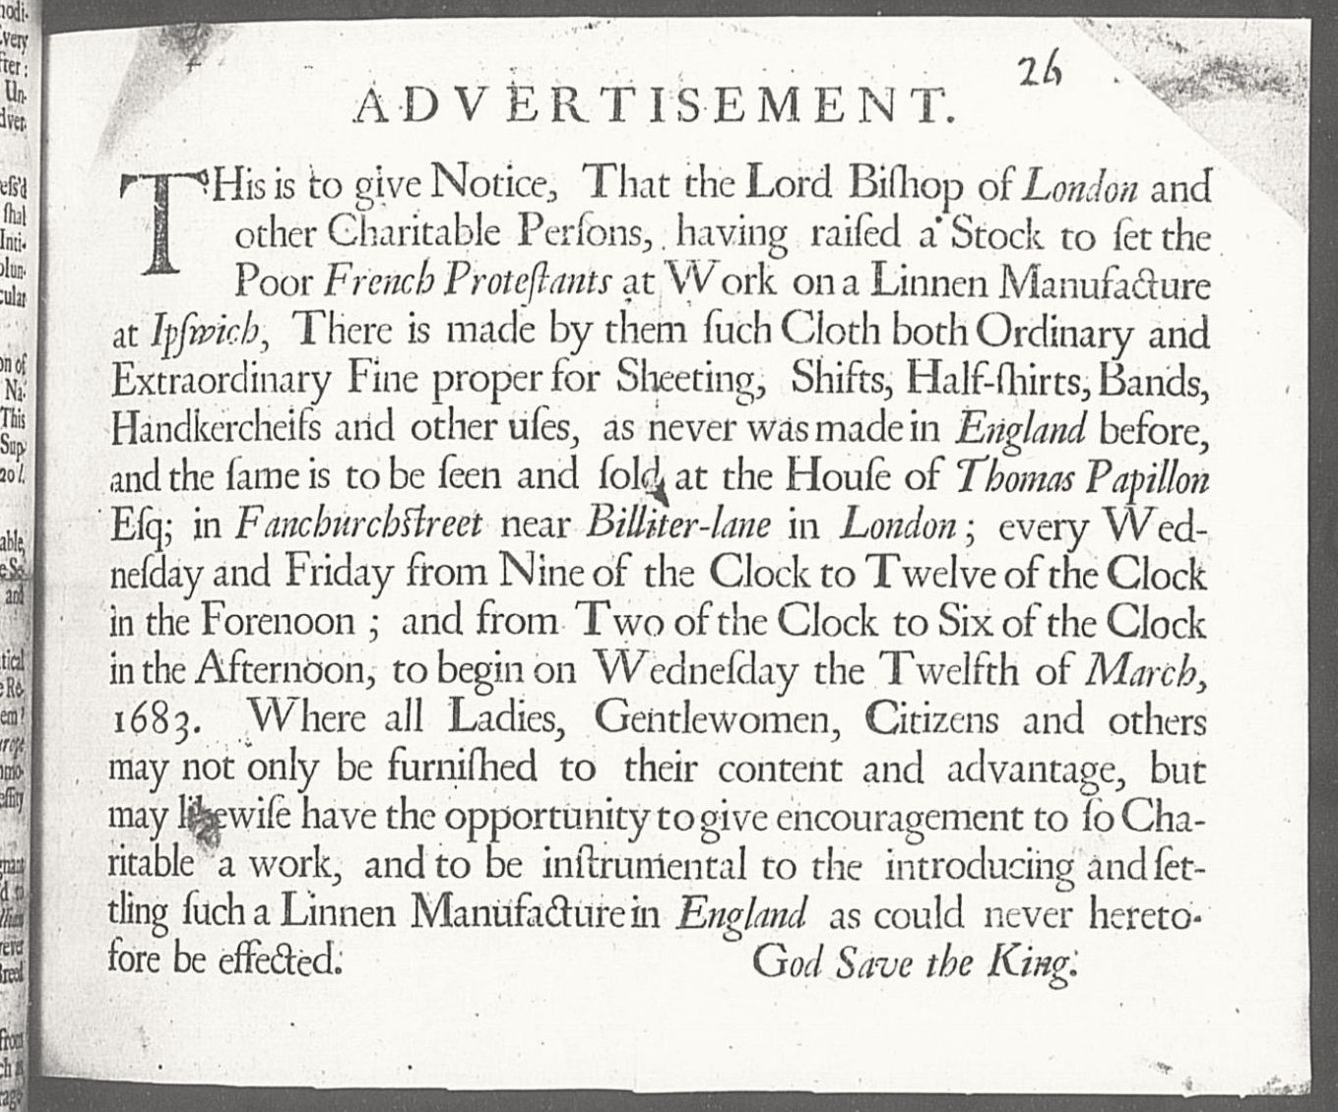
The plight of the Huguenots: Thomas Papillon's Advertisement
This ‘Advertisement’ was printed in 1683. It would have been circulated around London and attached to noticeboards in prominent places. It records the significance of a recognisable ‘poor’ community of French Huguenot refugees who were distinct from richer Huguenot merchants who were already established in England, like the Advertisement’s sponsor Thomas Papillon (1623-1702). The source offers an interesting and important insight into how earlier (in this case much smaller) communities of migrants would assist later arrivals.
Courtesy of Corpus Christi College, Oxford
www.ourmigrationstory.org.uk
Notes:
The purpose of this activity is to get pupils to think about the circumstances in which the men found themselves and to consider their reactions to those circumstances.

Slide 5
The plight of the Huguenots: Thomas Papillon's Advertisement
Origin – when was this source produced and by whom? How does this potentially affect its use as a source?
What can we learn from the source/what is its message?
Purpose – why was this source produced at this time?
Courtesy of Corpus Christi College, Oxford
www.ourmigrationstory.org.uk
Notes:
The purpose of this activity is to get pupils to think about the circumstances in which the men found themselves and to consider their reactions to those circumstances.

Slide 6
Huguenot silk weavers in Spitalfields
Published in 1709 by the Booksellers of London and Westminster and sold for 2d, ‘Canary-birds naturaliz’d in Utopia. A canto’ was intended to manipulate public opinion against the Bill for the Naturalization of Foreign Protestants, which was going through Parliament that year. The title was inspired by the canaries that the Huguenot silk weavers of Spitalfields kept in bird cages besides their looms to entertain them while they worked.
From 1681 Huguenot refugees to Britain could obtain a patent of denization, which brought with it the right to own property. Naturalisation, which brought additional rights of inheritance, was possible by private Act of Parliament, but it was expensive. A private bill could cost £50 or £60. Despite strong native opposition, an Act of General Naturalisation was passed in 1709, but was soon repealed.
www.ourmigrationstory.org.uk
Notes:
The purpose of this activity is to get pupils to think about the circumstances in which the men found themselves and to consider their reactions to those circumstances.

Slide 7
Huguenot silk weavers in Spitalfields
Origin – when was this source produced and by whom? How does this potentially affect its use as a source?
What can we learn from the source/what is its message?
Purpose – why was this source produced at this time?
www.ourmigrationstory.org.uk
Notes:
The purpose of this activity is to get pupils to think about the circumstances in which the men found themselves and to consider their reactions to those circumstances.

Slide 8
Attitude shown towards Huguenots in each source: | Source A | Source B
Reasons for the difference in attitudes | Description of these differences in the sources | How these explain the difference in attitudes
The sources have different purposes
The sources were produced by different people
The sources were written at different times
www.ourmigrationstory.org.uk

